Slide 1
Analysis of Time-Wasters on Social Media
Fasna

Slide 2
Introduction
Social media is widely used for entertainment and connectivity, but excessive use often leads to wasted time, addiction, and productivity loss.
Platforms like TikTok, Instagram, YouTube, and Facebook are analyzed for user engagement.
The dataset covers demographics, usage habits, addiction levels, and productivity impacts.
The study focuses on user behavior patterns, platform differences, and time-wasting effects.
The analysis highlights risks and suggests strategies for healthier social media usage.

Slide 3
Data Overview
Dataset: Social media usage data covering demographics, behavior, addiction, and productivity loss.
Users Covered: Respondents across different age groups, professions, and locations.
Total Records: 1000 rows × 31 columns
Key Features: Age, Gender, Platform, Watch Time, Addiction Level, Self-Control, Productivity Loss, Device, Connection Type, and Engagement.
Data Source: Kaggle

Slide 4
objectives
To analyze user behavior patterns across social media.
To evaluate the relationship between social media addiction and productivity loss across different platforms.
To study how the factors influence social media usage and addicition

Slide 5
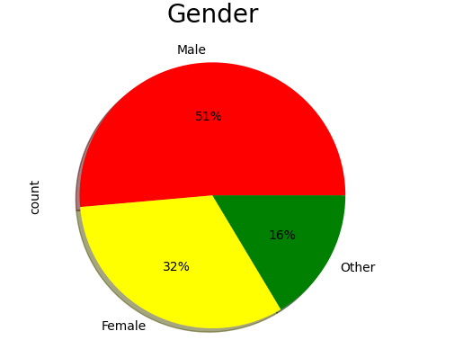
Gender Representation
The pie chart shows that 51% of the dataset identifies as Male, 32% as Female, and 16% as Other. This highlights a majority of Male entries in the gender distribution.

Slide 6
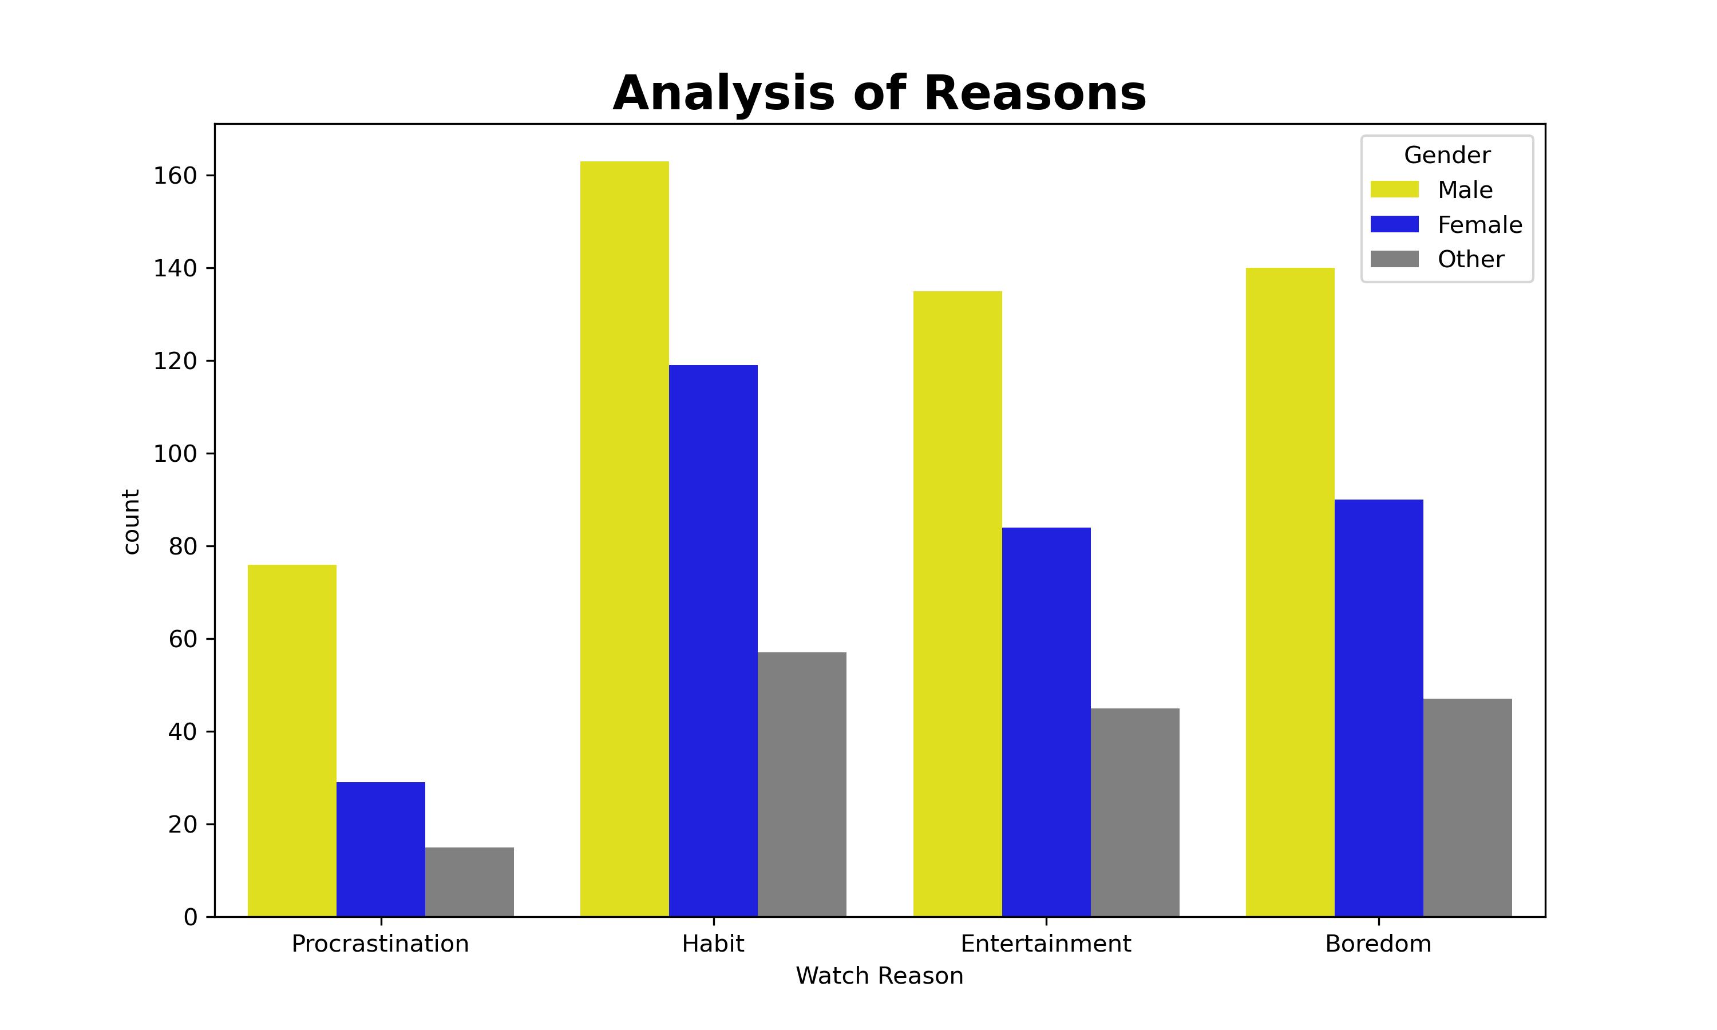
Comparison of Watching Reasons Across Genders
The most common reason to watch social media is a Habit,especially males.Entertainment and Boredom are also significant reasons

Slide 7
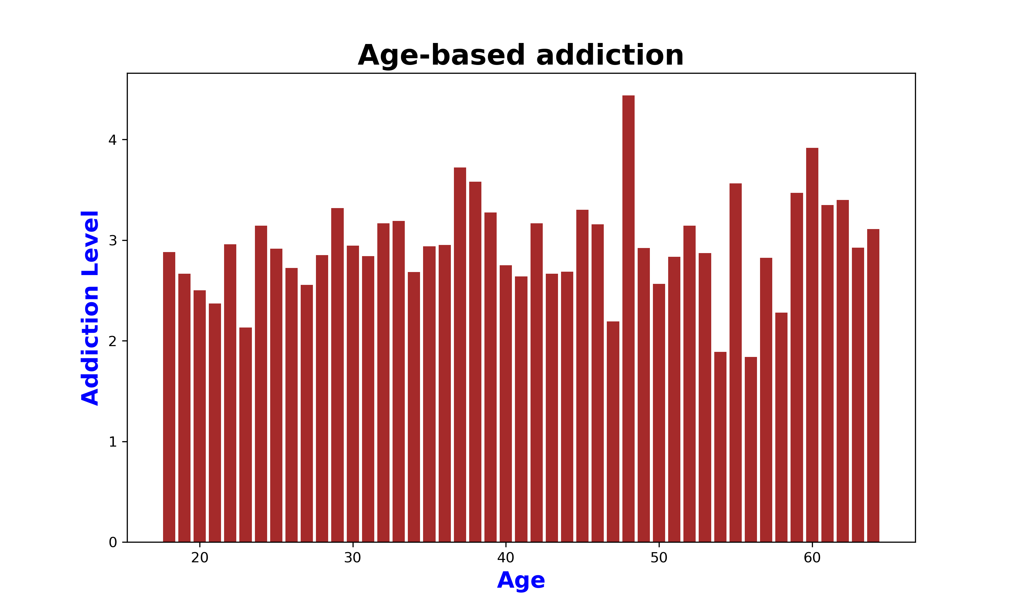
Addiction Levels Across Different Age Groups
It shows the addiction levels fluctuates across ages with noticeable spikes in middle age ranges

Slide 8
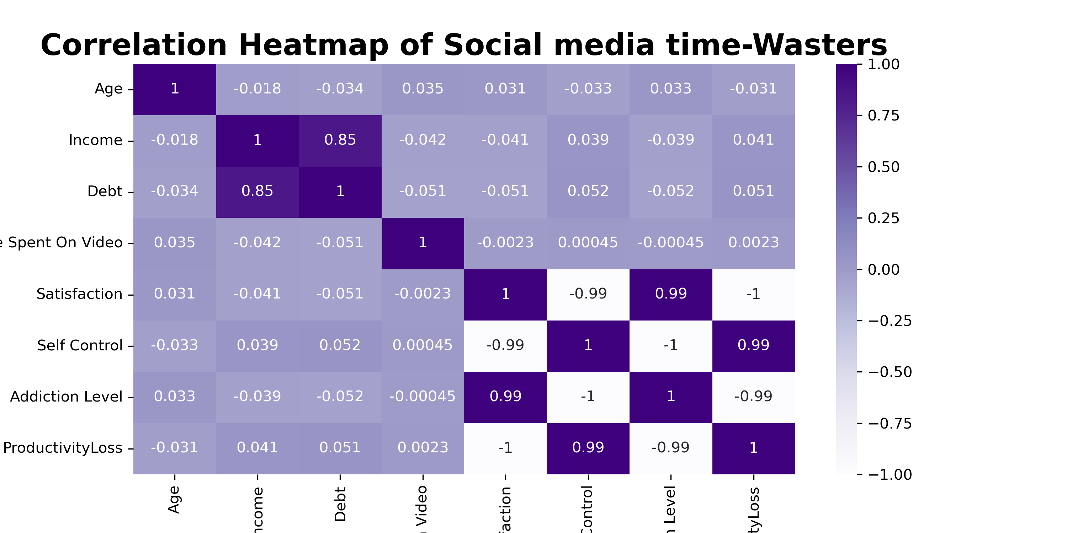
Social Media Usage Correlation Heatmap
Satisfaction, Self-Control, Addiction Level, and Productivity Loss are almost perfectly correlated, While income and Debt are highly correlated

Slide 9
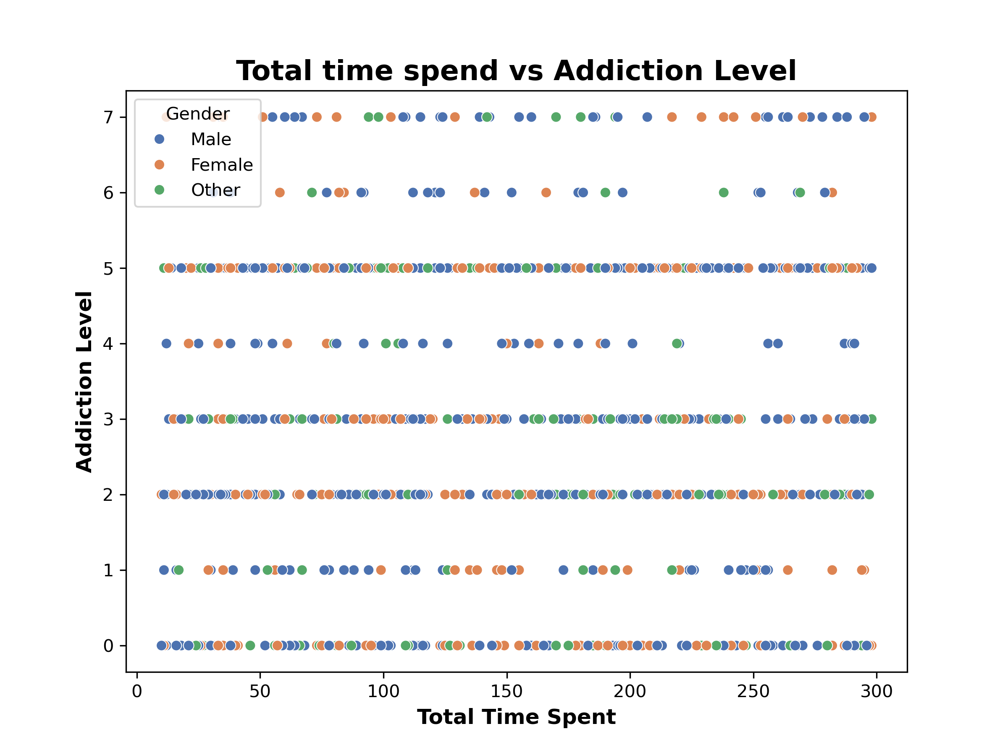
Time Spent vs. Addiction Level
The scatterplot shows that higher total time spent on social media generally corresponds to higher addiction levels, with little difference across genders.

Slide 10
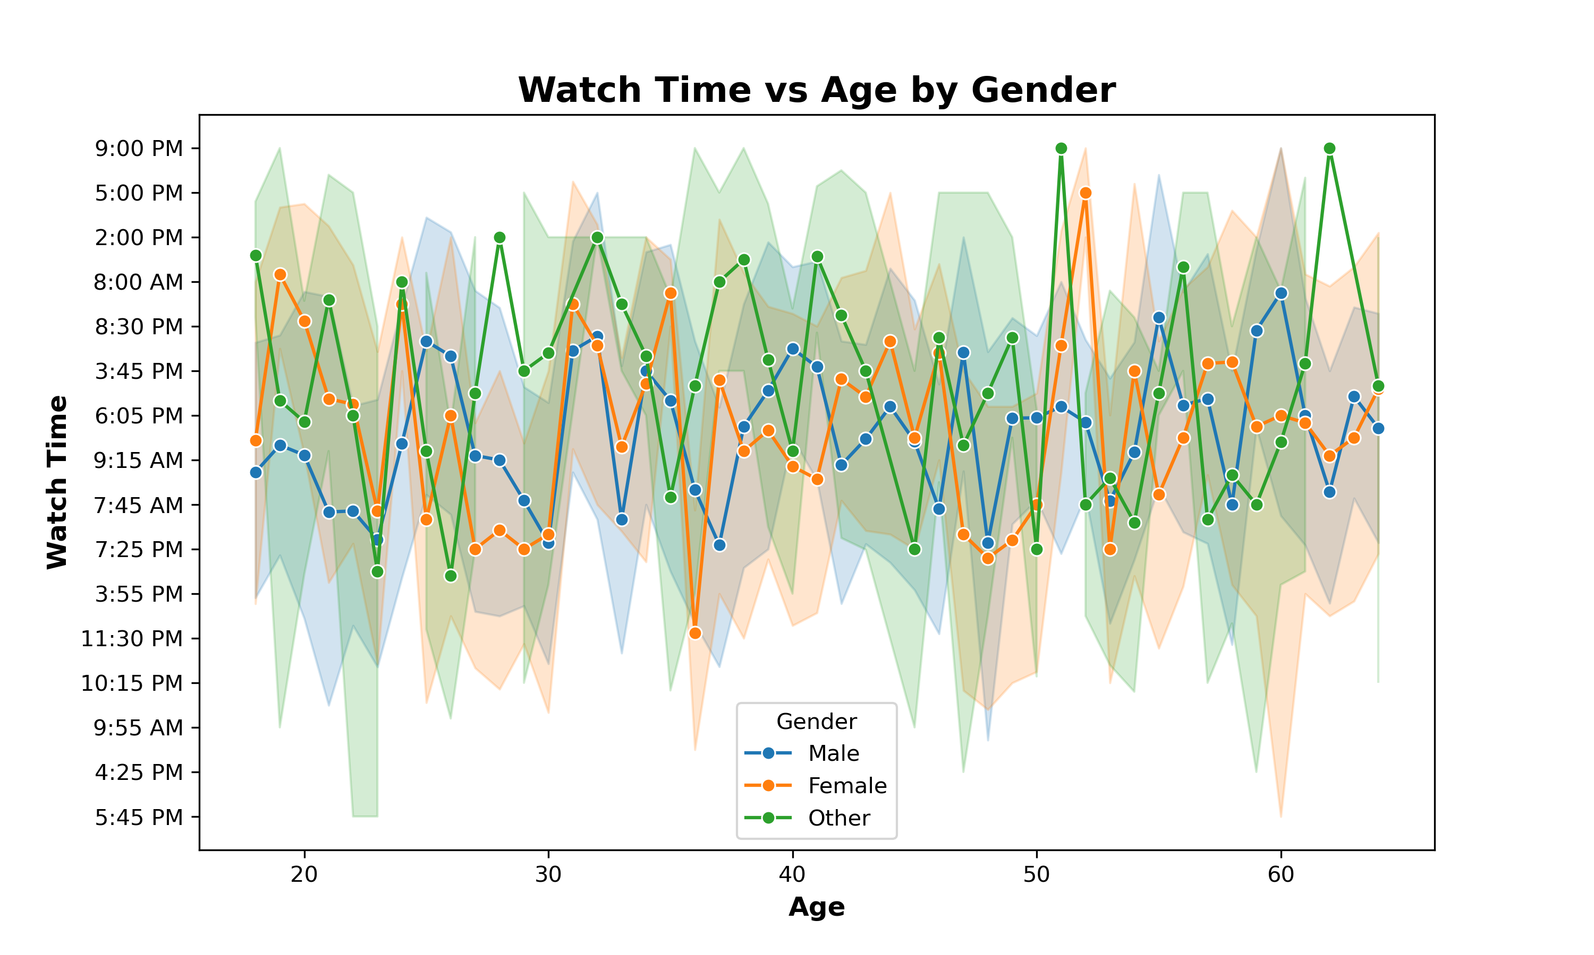
Watch Time by Age & Gender
Watch time Varies by age but shows no major differences across genders.

Slide 11
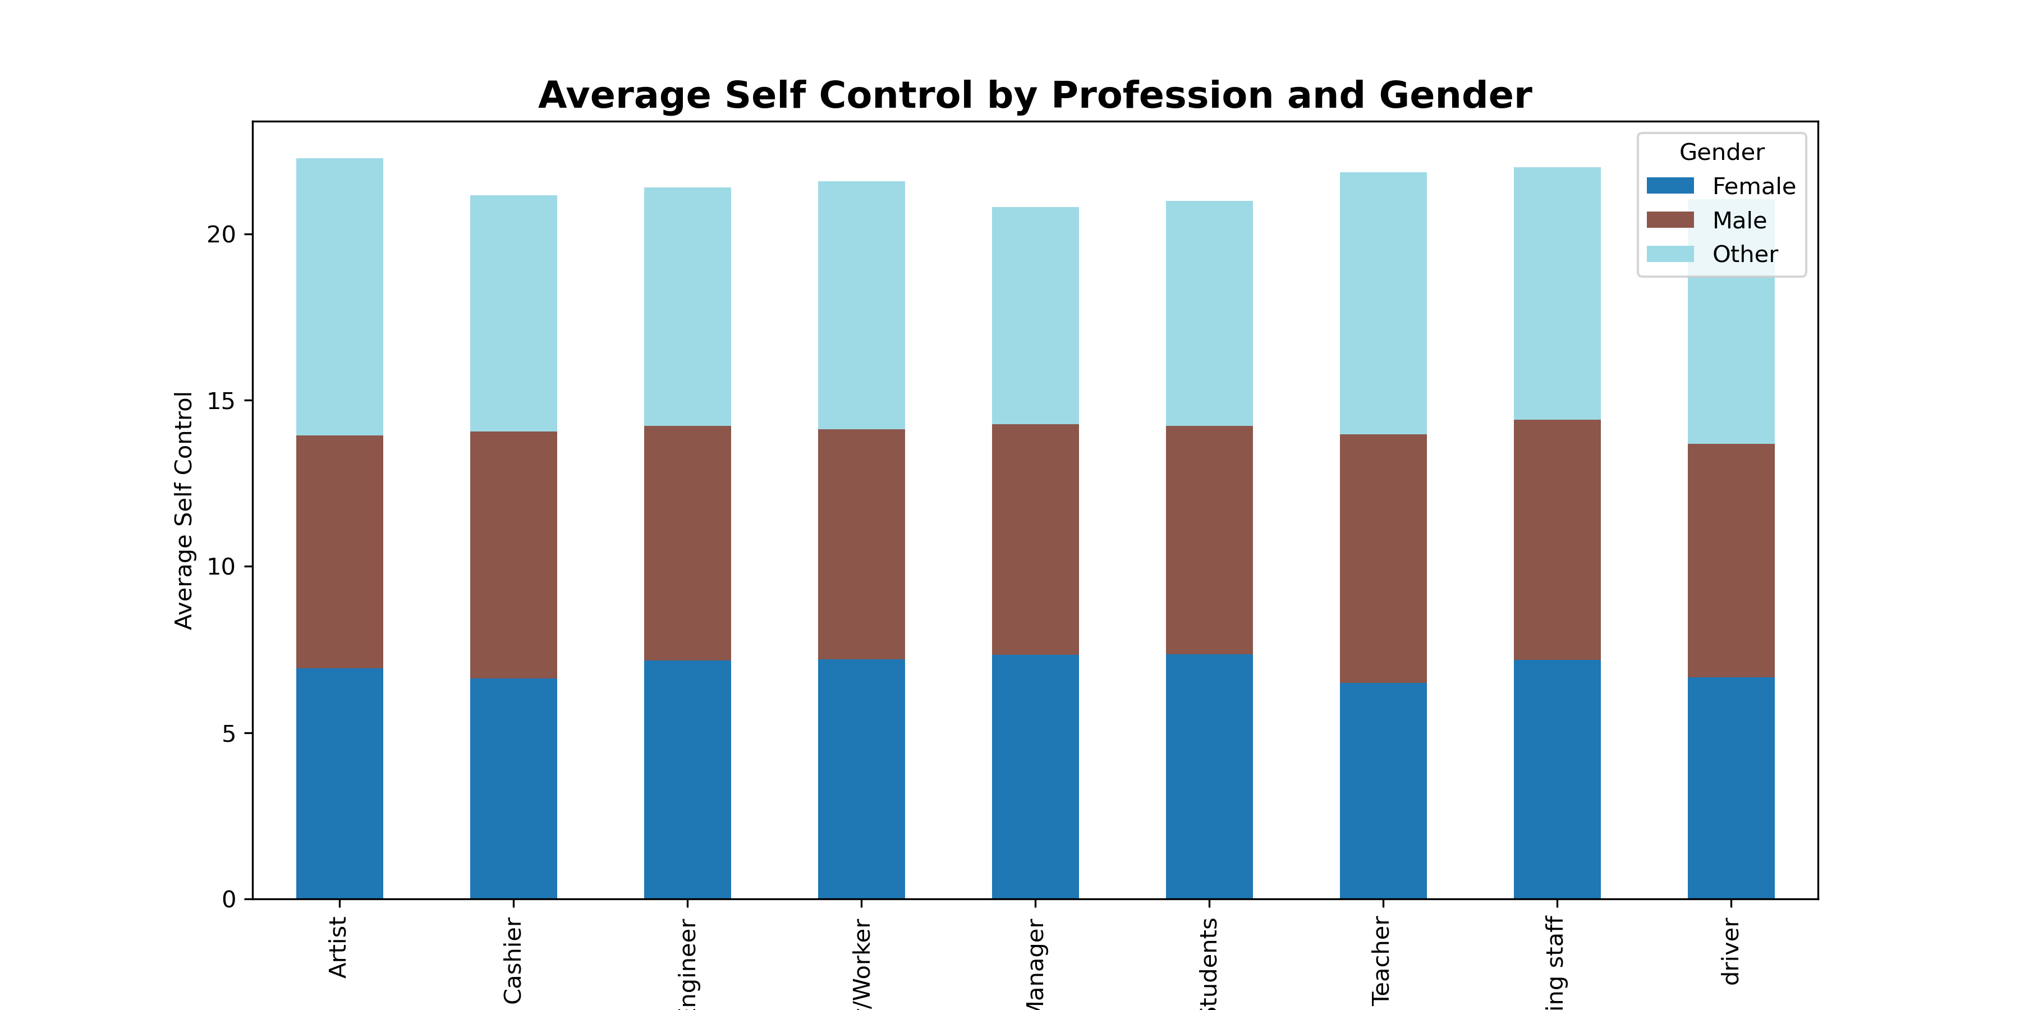
Self-Control by Profession & Gender
Self-control scores are steady across professions, with no major gender differences.

Slide 12
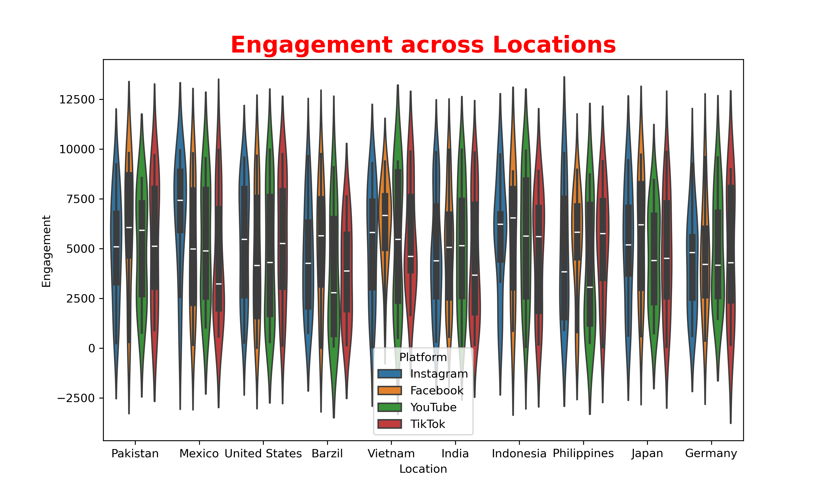
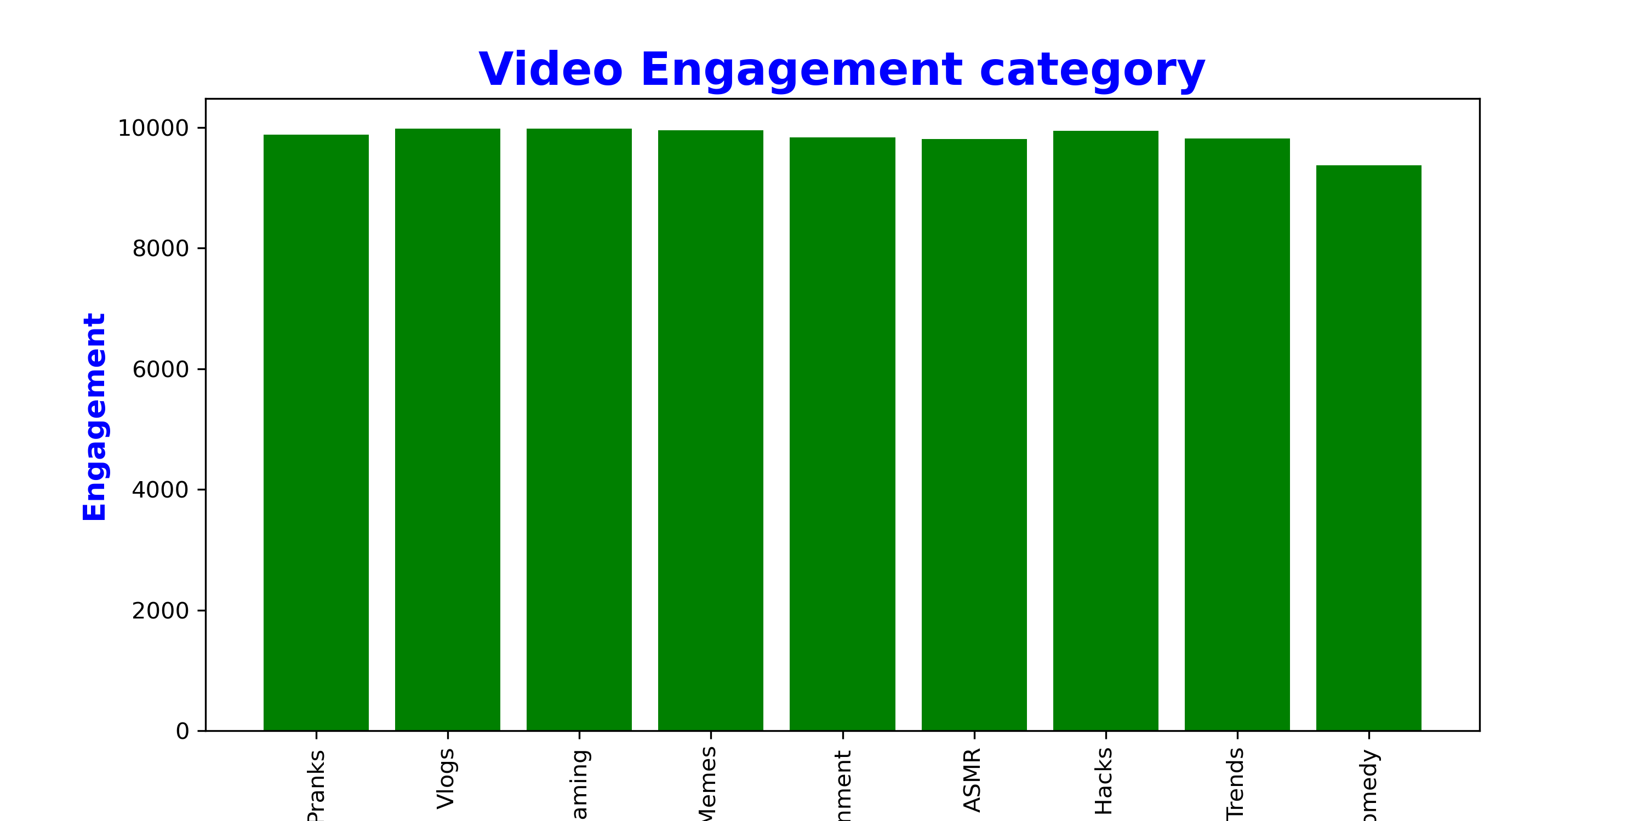
Social Media Engagement Across Locations and Categories
Engagement levels are broadly consistent across platforms and locations, though countries like Pakistan and India show more variability in engagement compared to others.
All video categories show similarly high engagement levels, with only slight variations Comedy has the lowest engagement, while Vlogs and Gaming perform the best.

Slide 13
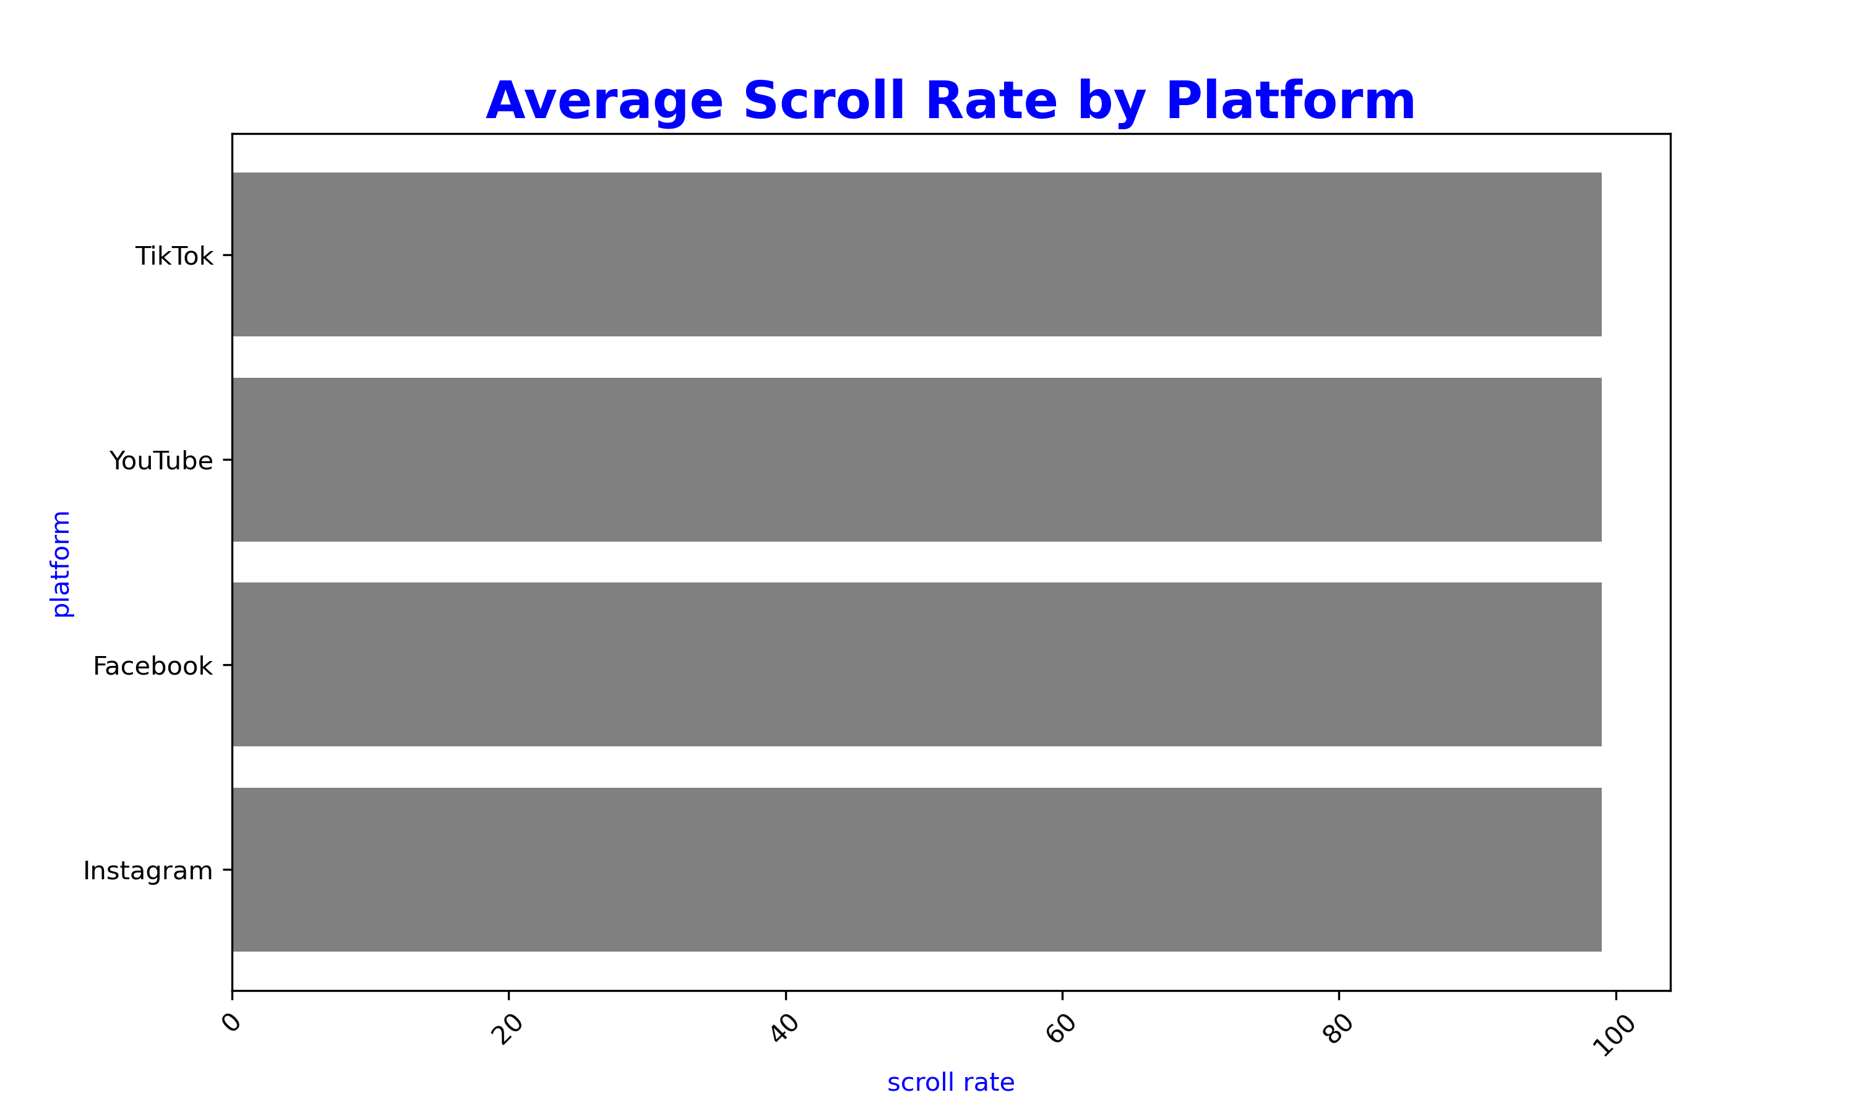
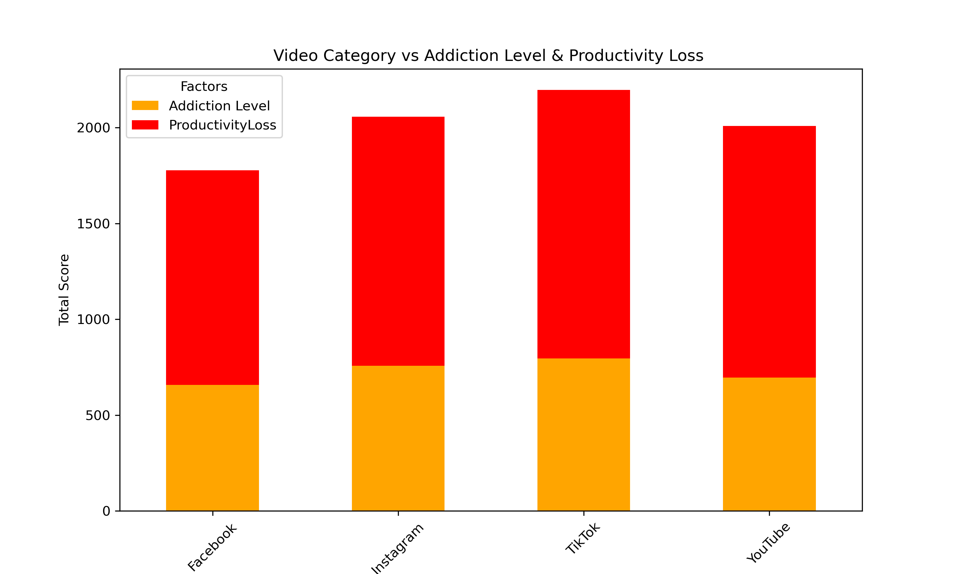
Platform Usage, Addiction, and Productivity Impact
Scrolling is a universal behavior across social media platforms, with little variation between them.
TikTok shows the highest combined addiction and productivity loss, followed by Instagram and YouTube, while Facebook has the lowest impact

Slide 14
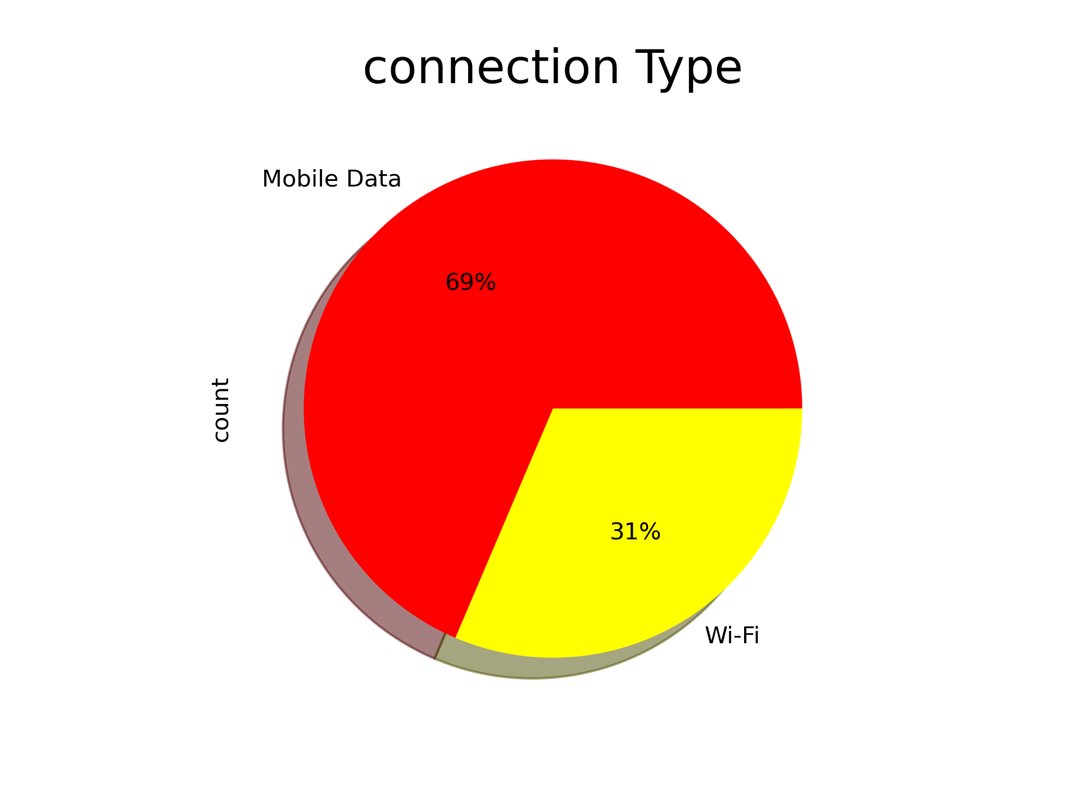
Connection Type Among Social Media Users
The majority of users (about two-thirds) are connecting via mobile data rather than Wi-Fi.

Slide 15
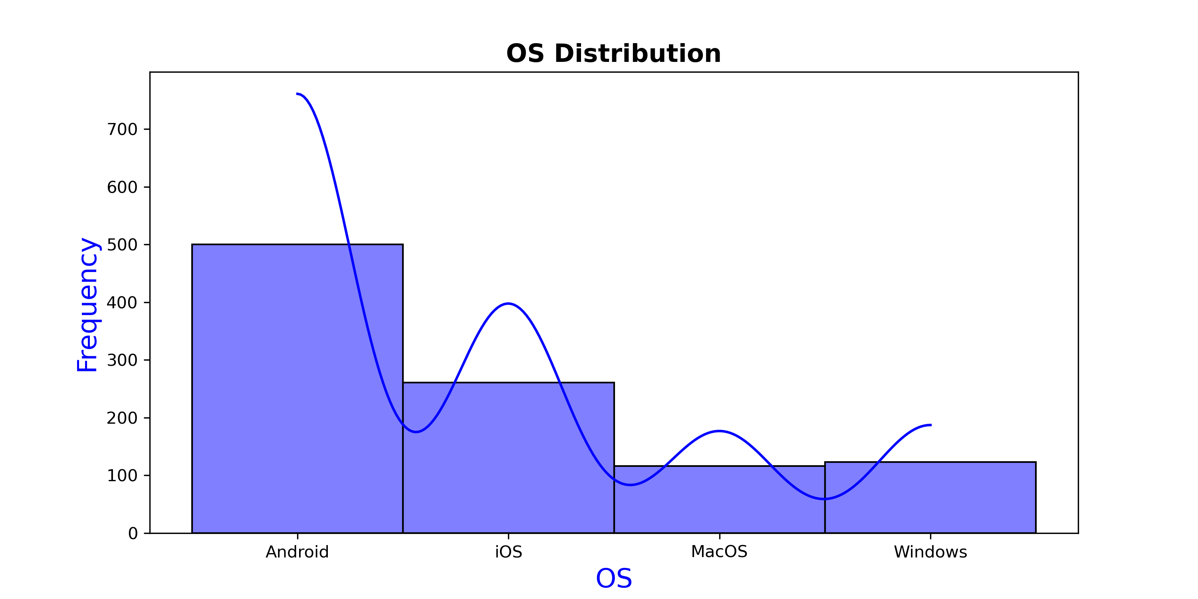
Operating System Usage Distribution
Most users access via Android (largest share) followed by iOS, while desktop usage (MacOS & Windows) is minimal, confirming a mobile-first audience.

Slide 16
Findings
Platform Usage: TikTok, Instagram, and YouTube are the most used platforms, showing higher engagement compared to Facebook.
Addiction Levels: Users on TikTok and Instagram exhibit higher addiction levels, especially among younger age groups.
Productivity Loss: A strong relationship exists between addiction and productivity loss — the more time spent on these platforms, the higher the reported decline in productivity.
Gender & Profession: Addiction levels and self-control are fairly similar across genders and professions, with no extreme differences observed.
Device & Connection: The majority of users access social media via mobile devices and mobile data, making it easily accessible and harder to control.
Self-Control: While some users show moderate self-control, addictive platforms like TikTok tend to override self-control more easily, leading to higher screen time.

Slide 17
Recommendation
Digital Wellbeing Tools : Encourage users to make use of built-in features like screen time limits, usage reminders, and app timers.
Awareness Campaigns : Educational programs in schools, colleges, and workplaces can spread awareness about the negative impact of excessive scrolling and video consumption.
Balanced Usage : Users can be guided to schedule fixed time slots for entertainment and avoid continuous scrolling, especially on TikTok and Instagram.
Productivity Substitution : Promote alternative apps or activities that support learning, fitness, or skill development to replace excessive entertainment consumption.
Policy Recommendations : Institutions and workplaces may consider setting digital boundaries to reduce productivity loss.

Slide 18
Conclusion
This study highlights how social media, while valuable for connectivity and entertainment, often leads to excessive use, addiction, and productivity loss. Findings reveal that platforms like TikTok and Instagram show higher risks, especially among younger users, with self-control and device accessibility playing key roles. By adopting digital wellbeing tools, raising awareness, and promoting balanced usage, individuals and institutions can reduce negative impacts and encourage healthier, more purposeful engagement with social media.

Slide 19
Thank You

